Slide 1
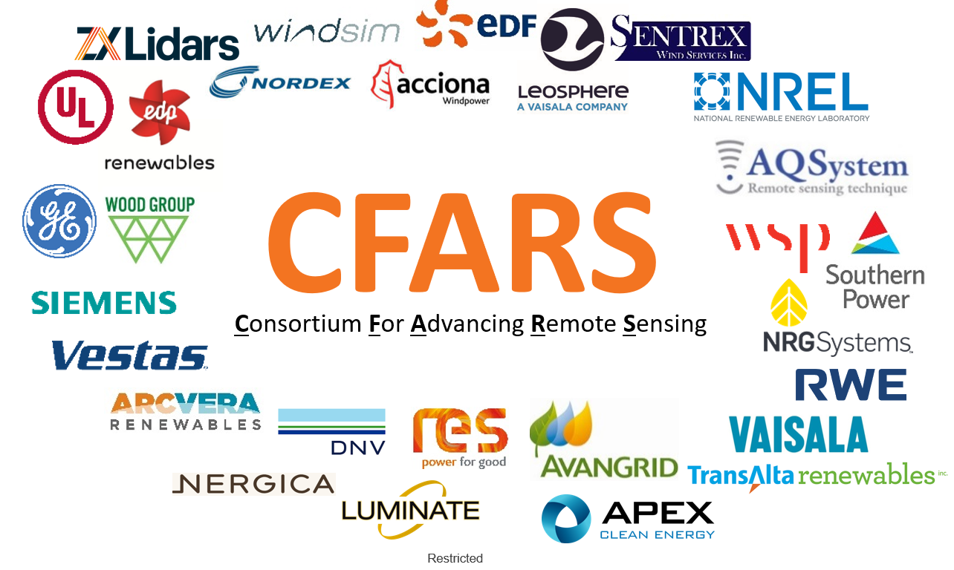
CFARS –General Meeting
Intro Session
April 13, 2021

Slide 2
CFARS - General Meeting – Agenda
Day 1 April 13th - Section #1
8:30MST to 9:00MST: Welcome! (We will officially start around 8:45)
Agenda Overview
Livestorm Meeting Functionalities… how do we interact in a digital world?
Registration to breakout groups Day 2
9:00 to 9:20: CFARS General Update --- Philippe Pontbriand TransAlta
Mission Vision Values
General roadmap update
Structure of CFARS and announcement of new leaders
2021 milestone
9:20 to 9:30: Jason Field NREL/IEC, Andrew Clifton IEA Task 32
IEC, IEA, Update on CFARS collaboration
9:30 to 9:40: Call for involvement - Philippe Pontbriand / Alexandra St. Pé – RWE
Science and Guidance Group sub mission/vision
Key needs for 2021
20 minutes break
Day 1 April 13^{th -} Section #2
10:00 to 11:30: Science Sub-group Updates – Alexandra St. Pé - RWE
Ti Correction: Update 2020 Results/2021 Roadmap - Alex Arnsten - NRG Systems
Power Curve Working Group: Share X – Machine Learning - Matthew Carter - RES
RSD Power Curve Testing: Where are we at? – Dan Bernadette - UL
Complex Flow 2020 Results/2021 Roadmap - Scott Wylie - ZXLidar
15 minutes break
11:45 to 12:00: Guidance Group: Andrew Hasting Black - Vaisala
Landscape of RSD Standards
Website and repo
12:00 to 12:15: Conclusions and Intro to Day 2

Slide 3
CFARS - General Meeting – Interacting in a Digital World
How to interact with the panel?
1- Questions can be asked on the tab
2- Questions will be answered at the end of each sections
4- Questions can be upvoted
5- CFARS is a social club… we encourage you to chat via the Livestorm tab

Slide 4
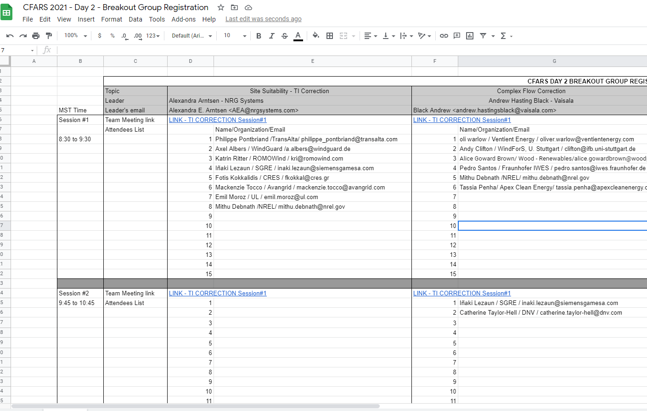
CFARS - General Meeting – Registration to Day #2
Please register to your preferred day 2 sessions
Link to the Google Sheet in the Chat
Install Microsoft Team and click on the link
Day 2 Objectives:
Get enrollment to the working group
Gather experience / feedback
Define subgroup 2021 roadmaps and priorities
This is your chance to participate and get heard

Slide 5
CFARS - Overview
_{Who}
_{Why}
_{How}
Since 2018 members:
Major North American wind project owners, developers, operators, 3rd consultants, OEM and tech providers
Industry RSD facilitor:
Working group enabling collaboration on projects promoting the acceptance and standardization of Remote Sensing use onshore.
Private industry players:
Private players supporting the different groups working on remote sensing use acceptance and standardization.
Create consensus:
Seek industry consensus around the use of RS. Speak with a common voice.
Build bridges:
Build bridges between industry players, research centers, standardization body and tasks. Support IEA-Task 32 / IEC 61400-15 working group.
Rapidly address private industry RS needs :
Steer short term projects aimed at supporting private industry needs
Access to information
Give access to a large pool of industry RS data from private sector.
Support RS validation projects
Join members' resources to support short term practical projects validating use of RS
Jointly present results
Present compelling results to banks (tax equity), the broad industry and other stakeholders
Notes:
Explain the consortium. The have people involved stand up.

Slide 6



CFARS Mission – Vision - Values
Mission
Vision
Increase acceptance of Remote Sensing Device (RSD) by sharing information and involving the broad industry
Reduce project development costs by supporting/enabling standardization and acceptance of RSD
Reduce uncertainty of pre-construction estimates by demonstrating and leveraging the value of RSD
Significantly contribute to the competitiveness of the wind industry by 2021 through broader acceptance/validation of RSD
Values
Open
Collaborative
LOW ENTRY BARRIER
INFORMATION SHARING
INCLUDE MEMBERS FROM ALL HORIZON
SHARE BEST PRACTICES
SOCIALIZE FINDINGS
Results Driven
Leadership
CLEAR GOALS
SHORT TERM GOALS
UNITED MESSAGE
SUBGROUP CHAMPIONS

Slide 7
CFARS - Key Achievements
CFARS milestone | Description
2018 Official expression of interest by members 2018 First official consortium meeting | Seek formal expression of interest by members Get commitment from members to make the consortium a success Get commitment to take part in the consortium meeting Creation of the working groups (Guidance, Science) and assignment of group leads
2019 Presentation at AWEA of survey results | Definition of our key focus work: TI, Complex Flow, Power Curve
8 General Meetings 3 Webinars 5 panel presentation at AWEA and WindEurope 4 Active workgroups (countless meetinga) 30 major organization actively involved and growing
2021 First White Paper Initial proposal acceptance framework | Now is time to get involved to close our initial roadmap…

Slide 8
CFARS – The 2021 Horizon and 2021 Roadmap
Science
Improve acceptance RSD via science
Evaluation of Industry Status
We are here
First White Paper
TI Correction
Short Term - Q1/2 - 2019
Long Term - Q1/3 - 2021
Medium Term - Q2/3 - 2020
Final State - Q4 - 2021
Guidance
Improve acceptance of RSD via guidance
Acceptance Criteria
Evaluate acceptance
Criteria framework

Slide 9
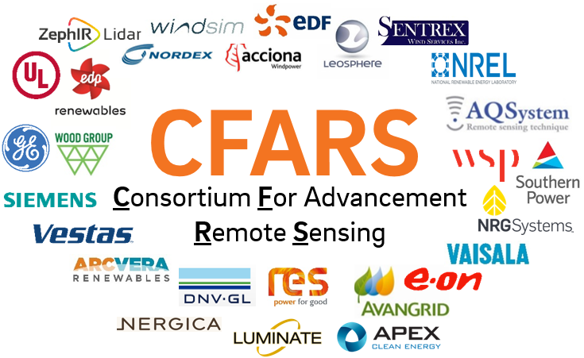
CFARS – Survey Objective
Create a credible/unbiased acceptance baseline for onshore vertical profiling RSD use and acceptability
Understand current perceived limitation/boundaries for commercial use of RSD
Probe RSD users about common area of knowledge vs diverging practices
What is now understood vs what needs to be understood better
Provide some directions/area of focus for the Science tract

Slide 10

CFARS – Survey Structure
Part 2 - RSD Deployment History Table
Part 1 - RSD Questions
1. General Perspective
2. Campaign Design
3. Installation/ Deployment
4. RSD Operation
5. RSD Validation
6. RSD Data Processing for EYA
7. RSD Data for LT Wind Assessment
8. RSD Data for Wind Flow Modeling
9. RSD Data Consideration for Site Suitability
10. RSD During WF Operation & PPT
11. RSD Measurement Uncertainty
12. RSD Maintenance
13. Other / Misc.
1. General Information
2. Climate Type
3. Air Quality Impacts on Data Recovery
4. Success – How Data is Used
5. Failure – Reasons for Data not being Used
Some Fact on the Survey
145 questions
5 hours to complete
Still got representative level of participation…. Tx!

Slide 11
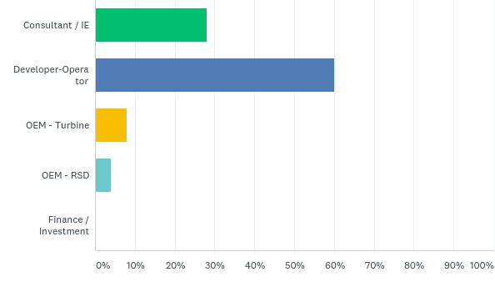
CFARS - Survey Participants
Answered: 25 Skipped: 0
7 independent companies
15 independent companies
2 independent companies
1 company

Slide 12
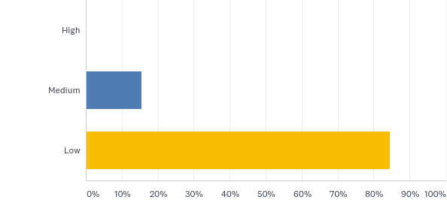
CFARS - Survey Findings
Section 9: How much confidence do you have that an OEM would only use RSD data for a site suitability report?

Slide 13
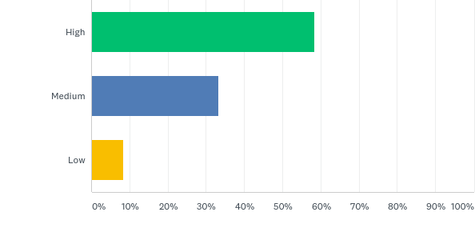
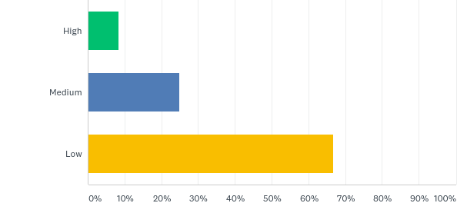
CFARS Survey Findings
Section 9: What is most important consideration when siting an RSD
SHEAR
TI

Slide 14
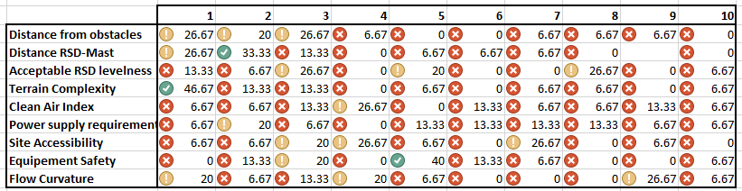
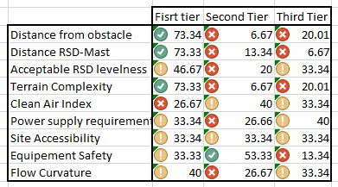
CFARS Survey Findings
Section 3: What is most important consideration when siting an RSD
Complex flow is clearly #1 criteria

Slide 15


























CFARS Working Groups
Guidance
Working Group
CFARS
Consortium For Advancement Remote Sensing
Science
Working Group

Slide 16
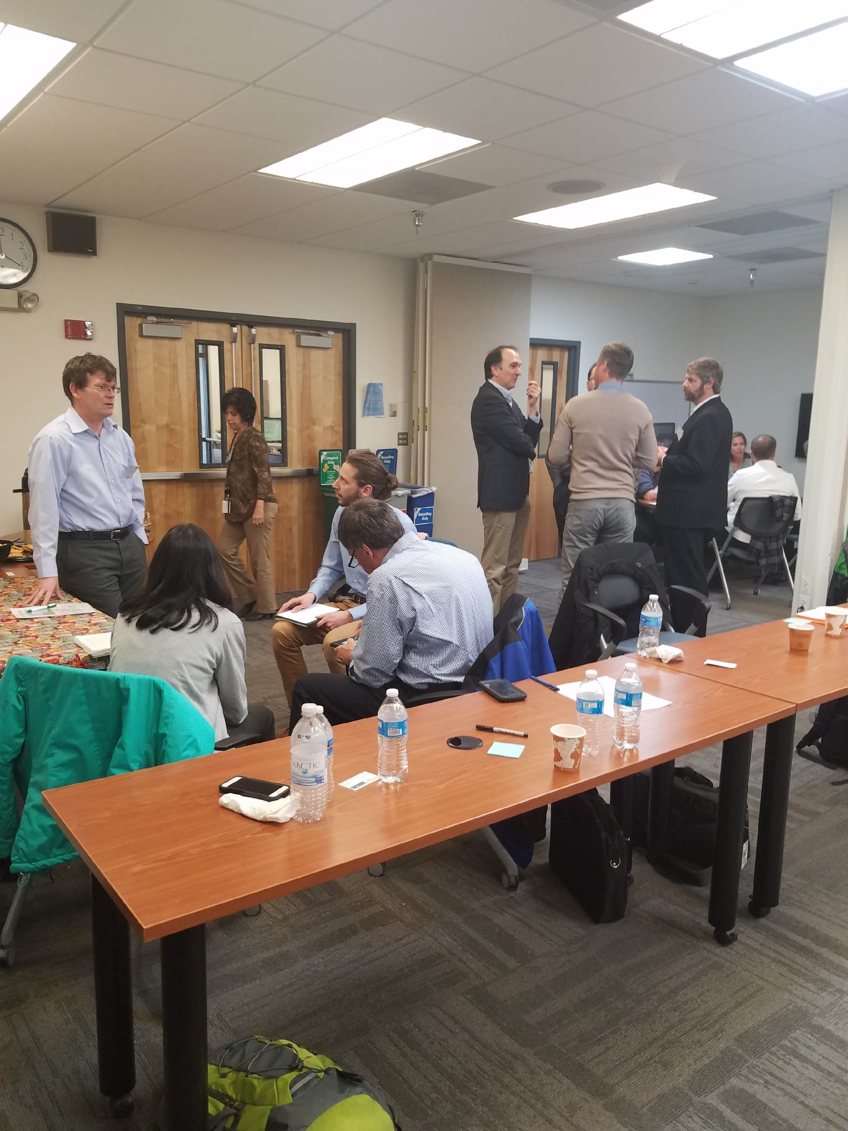
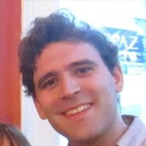
CFARS Guidance Working Group – Andrew Black Vaisala
CFARS
Guidance
Working Group
Increase Acceptance of RSDs
Scope 1
Baseline
2019 Survey
Scope 2
Acceptance
Framework
TI Correction
Flow
Correction
Mission:
Provide Data-Driven Recommendations on RSD Standardization and Acceptance
Andrew Black – Group Lead

Slide 17
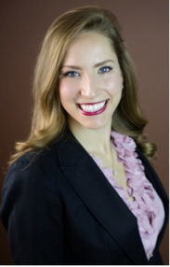

CFARS Science Working Group – Alexandra St. Pé E.ON
CFARS
Science
Working Group
Increase Acceptance of RSDs
Complex Flow
Correction
Power
Curves
TI
Correction
PCWG/CFARS
Joining Force
2020!
Mission:
Provide Data-Driven Answers to Key RSD Science Questions
Alexandra St. Pé – Group Lead

Slide 18

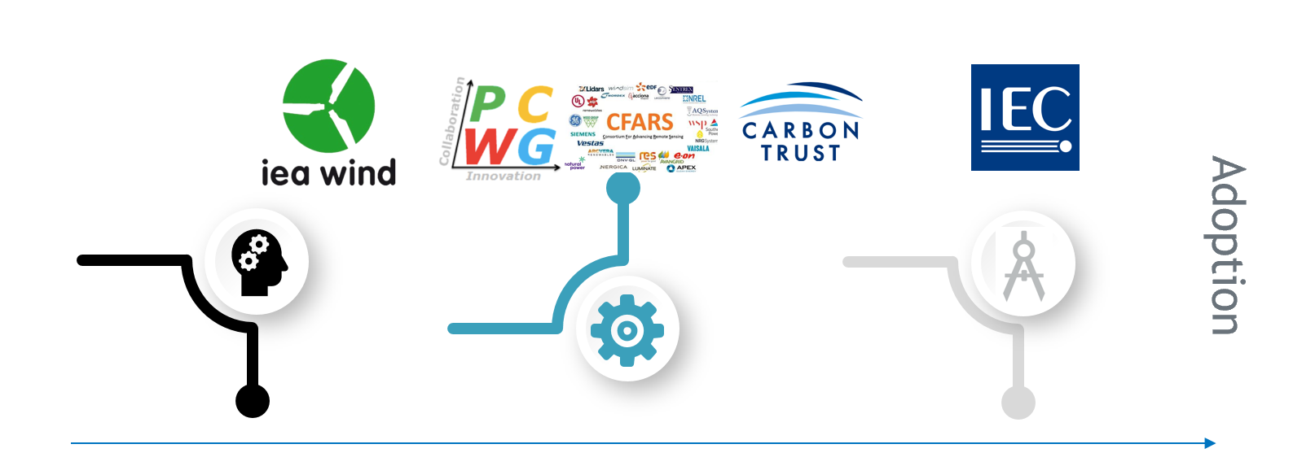
Map of the Various RSD - RSD Initiatives
Specific Scope
Common Objective
Untested territories
New concepts
Mitigate Barriers to Commercial Use of Remote
Sensing Device in Power Performance Applications
R&D:
Implementation:
Demonstration
Normative:
Guidance (Pre-Normative)
Standards

